Slide 1
Proposals for 2017 Leadership and Governance (LDG) Learning Programmes
(For Discussion)

Slide 2
Learning Needs Analysis (LNA) for
LEADERSHIP (2017)

Slide 3
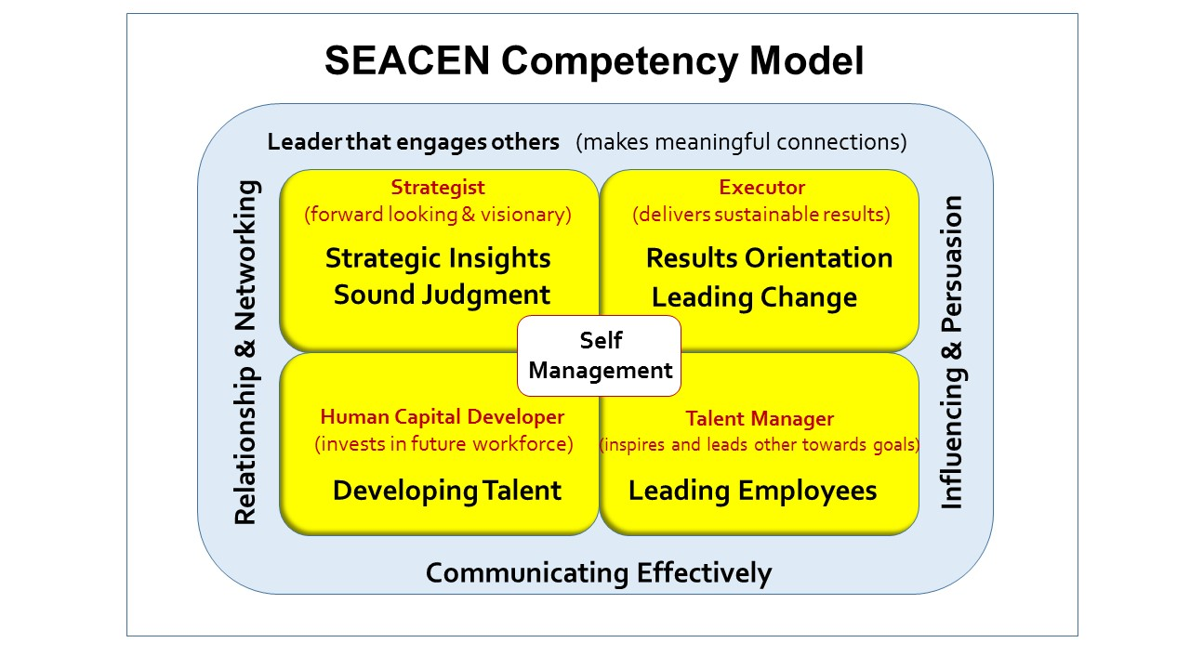
Leadership LNA Survey Approach
Strategic Insights
Self-Management
Sound Judgement
Result Orientation
Leading Employee
Leading Change
Relationships and Networking
Developing Talent
Communicating Effectively
Influencing and Persuasion
Members banks were asked to rate the following SEACEN Leadership Competencies based on their needs i.e. High, Moderate, Low and No Need
Member banks were also asked to indicate which competencies should be specifically covered in SEACEN Leadership Intermediate and Advanced programmes.
16 out of 20 members responded to the LNA

Slide 4
Proposed Leadership Competencies to be Covered based on Members’ Needs (2017)
Leadership Competencies | High Need | Moderate Need | Low Need
Strategic Insights | 69% | 25% | 6%
Influencing and Persuasion | 63% | 37% | 0%
Leading Employees | 56% | 31% | 13%
Result Orientation | 44% | 56% | 0%
Leading Change | 44% | 56% | 0%
Developing Talent | 44% | 56% | 0%
Communicating Effectively | 44% | 50% | 6%
Self-Management | 38% | 56% | 6%
Relationships and Networking | 31% | 56% | 13%
Sound Judgement | 25% | 75% | 0%
Three competencies which the majority indicated as HIGH NEED will feature as individual sessions in Intermediate and Advanced programmes.
In addition, under competencies indicated as MODERATE NEED, there is a higher demand for one competency, i.e. Developing Talent, to be covered under Advanced programmes. This will therefore also feature as an individual session in Advanced programmes.
Other competencies will be embedded as part of the sessions and activities.

Slide 5
LNA for
GOVERNANCE (2017)

Slide 6
Governance LNA Survey Approach
Legal Mandate for Central Bank
Governance in Maroprudential Policy Framework (Systemic Stability)
Governance in Crisis Management and Resolution
Governance in Microprudential Framework (Supervision and Regulation)
Governance in Monetary Policy
Governance in Central Bank Financial Settlements
Member Banks were asked to rate the above proposed learning programmes based on their needs: i.e. High, Moderate, Low and No Need
15 out of 20 members responded to the LNA

Slide 7
Proposed Governance Learning Programmes (2017)
Course | High Need | Moderate Need | Low Need
Governance in Macroprudential Policy Framework (Systemic Stability) | 73% | 20% | 7%
Governance in Crisis Management and Resolution | 60% | 40% | 0%
Governance in Microprudential Framework (Supervision and Regulation) | 60% | 33% | 7%
Legal Mandate for Central Bank | 53% | 27% | 20%
Governance in Monetary Policy | 47% | 40% | 13%
Governance in Central Bank Financial Statements | 27% | 67% | 6%
Proposed Programmes for 2017:
Individual programmes (as indicated by the majority as HIGH NEED); and/or
Programmes that cover a mix of 2-3 areas

Slide 9
Appendix
Sub-Topics for Governance Programmes

Slide 10
1. Governance in Macroprudential Policy Framework (Systemic Stability)
Learning Objective: Using international comparisons, participants will seek to determine an effective macroprudential policy framework for their jurisdictions. Target Audience: Senior level central bank staff involved in the analysis of macroprudential issues. Having experience in drafting policy decisions is an advantage.
Key Topics:
Scope of Macroprudential Policy
Range of Institutions Involved
Role of Central Bank
Type of Instruments and Powers
Decision Making Protocols
Procedures for Assessment of Policy Delivery
Case Study on Macroprudential Policy Framework

Slide 11
2. Governance in Crisis Management and Resolution
Learning Objective: Using international comparisons, participants will seek to determine an effective crisis management framework for their jurisdictions. Target Audience: Heads of department (Directors) involved in crisis management issues. Experience in dealing with cross institutional matters would be an advantage.
Key Topics:
Nature of Crisis Management Protocols and Resolution Frameworks
Roles of Central Bank
Type of Instruments and Powers
Decision Making Protocol
Procedures for Holding Decision Makers to Account
Case Study / Simulation

Slide 12
3. Governance in Microprudential Framework (Supervision and Regulation)
Learning Objective: Using international comparisons, participants will seek to determine an effective microprudential framework for their jurisdictions. Target Audience: Senior level central bank staff involved in the identification of vulnerabilities in financial institutions. Having previous experience in onsite supervision is an advantage.
Key Topics:
Scope of Microprudential Policy
Role of Central Bank
Capabilities and Resources Required
Type of Instruments and Powers
Implications for Regulation and Enforcement
Procedures and Indicators for Assessment of Performance of Microprudential Functions
Case Study on Microprudential Policy Framework

Slide 13
4. Legal Mandate for Central Bank
Learning Objective: Using cross country comparisons, participants will be able to determine the best way to give the CB a solid legal basis for the performance of its policy functions Target Audience: Senior CB lawyers involved in preparing legislation relating to central bank
Key Topics:
Piecemeal vs Comprehensive Reform
Process of Preparing the Legislation
How granular should the legislation be?
Legal protection and immunities
Appeals of central bank decisions. Judicial recourse.
Case studies (Malaysia, Thailand)

Slide 14
5. Governance in Monetary Policy
Learning Objective: Using international comparisons, participants will seek to determine an effective monetary policy framework for their jurisdictions. Target Audience: Senior level central bank staff involved in the analysis of monetary policy issues.
Key Topics:
Underlying Analytical Framework
Responsibility and Power to Collect and Analyse Information
Power to Use Market based Policy Instruments
Power to Use Administrative Measures
Centralized vs Decentralized
Committees and Departments
Decision-making Protocols
Policy, delivery, process and resources

Slide 15
6. Governance in Central Bank Financial Statements
Learning Objective: Using both overview material and case studies, participants will seek to understand how central bank’s operations are reflected in the CB financial statements (balance sheets and profit and loss accounts) Target Audience: Senior level central bank staff whose responsibilities have direct or indirect impact on CB financial statements
Key Topics:
Schematic/Typology of CB Balance Sheet
Accounting Standards
Factors Affecting the Composition and Size of Balance Sheet
Factors Affecting CB Profits and Losses
Income Recognition and Profit Allocation
Indemnification and Dealing with Losses

