Slide 1
SEACEN-BIS High-Level Seminar
Financial Inclusion Strategies:
The Role of Central Banks
Comments on the presentation by Professor Agarwal
Hans Genberg
The SEACEN Centre

Slide 2
Outline
Financial Inclusion vs. Financial Access
What do we know about the effects of financial access?
What role for policy?
Financial inclusion and monetary policy
Financial inclusion and financial stability

Slide 3
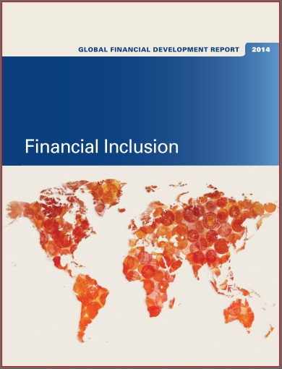
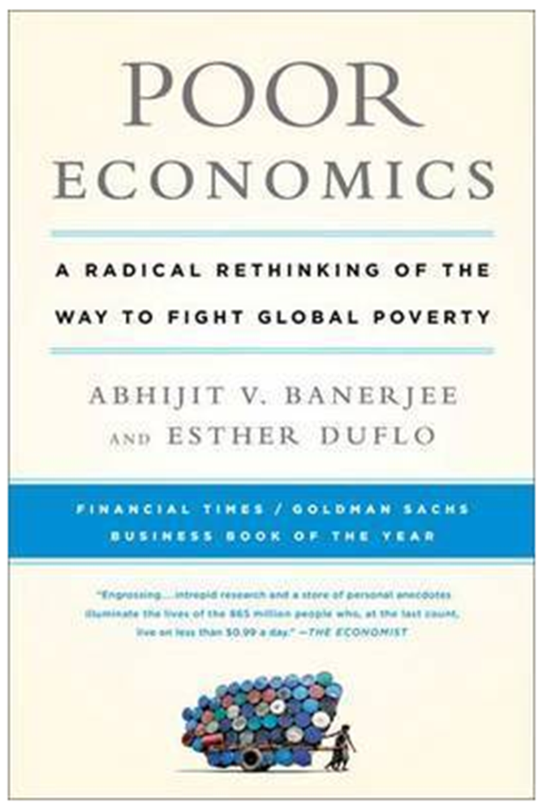

Slide 4
1. Financial Inclusion vs. Financial Access
“Creating new bank accounts does not always translate into regular use.”
“Financial inclusion is defined here as the proportion of individuals and firms that use financial services. The lack of use does not necessarily mean a lack of access.”
Global Financial Development Report, 2014. World Bank

Slide 5
Half the world’s population – more than2.5 billion people – do not have an account at a formal financial institution.
Why?
Lack of trust
Distance
Not enough money

Slide 6
Why?

Slide 7
2. What do we know about the effects of financial access? Results from randomized impact evaluations.
Access to microcredit:
Small businesses benefit
Mixed evidence for households
Savings
Offering access to savings accounts does increase savings of those who make use of them. But only a fraction of people do. ‘Nudging’ the very poor to save seem to help.
Insurance
The uptake of insurance is strikingly low. (Lack of trust, liquidity constraints)
Mobile money
Reduces households’ transaction costs and seems to improve their ability to share risks.

Slide 8
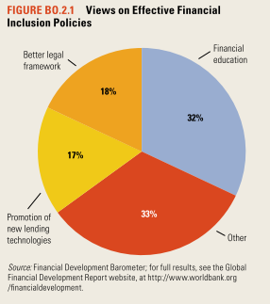
3. What role for policy?
Lack of trust.
Improved legal framework.
Lack of knowledge about basic financial products and services.
Financial education.

Slide 9
One size does not fit all.
“Understanding the specific constraints generating lack of financial inclusion in an economy is critical for tailoring policy recommendations.”
‘Identifying Constraints to Financial Inclusion and Their Impact on GDP and Inequality: A Structural Framework for Policy.’ Dabla-Norris, Ji,Townsend, and Unsal. IMF WP/15/22. January 2015.

Slide 10
4. Financial inclusion and monetary policy
Drawing a larger fraction of the population into the financial system is likely to increase the effectiveness of changes in the policy interest rate?
This also means that the monetary policy transmission mechanism evolves over time and needs to be internalized by policy makers.
Monetary policy almost always has distributional consequences. These now affect a larger proportion of the population.
Greater financial inclusion means greater opportunities to smooth consumption over time.
The central bank can tilt its ‘objective function’ a bit towards fighting inflation (Yetman, SEACEN-BIS Seminar, 2014, Kathmandu)

Slide 11
4. Financial inclusion and financial stability

Slide 13
THANK YOU

